Slide 1
Paper 1
The Influence of Caption Features on Clickthrough Patterns in Web Search
Clarke, C. L., Agichtein, E., Dumais, S., & White, R. W. (2007)
Paper 2
On Caption Bias in Interleaving Experiments
Katja Hofmann, Fritz Behr & Filip Radlinski (2012)
- Hrishikesh Gadkari
1

Slide 2
The Influence of Caption Features on Clickthrough Patterns in Web Search

Slide 3
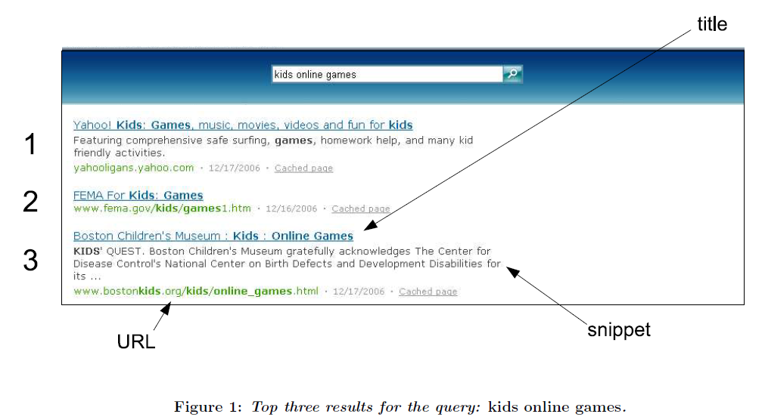
About Captions
To assist the user in determining the relevance of the associated page without actually having to click through to the result.
Notes:
About clickthrough

Slide 4
In This Paper
Introduce clickthrough inversion and caption pairs, that better represents the implicit indicators of user preference
Examine the influence of caption features on user’s Web search behavior, using clickthroughs extracted from search engines logs
The characteristics of the feature tags aspects of the captions
Notes:
what features of caption pairs, if any, lead users to prefer
one caption over another.

Slide 5
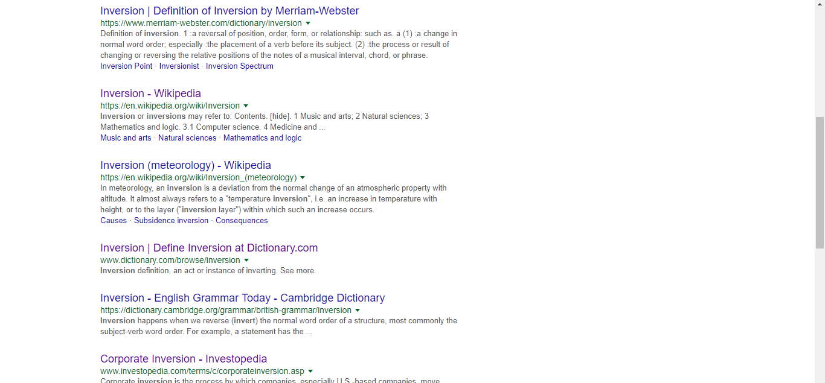
Clickthrough Inversion
N
N+1
Before Inversion
Caption A: N, Caption B: N + 1
After Inversion
Caption B: N, Caption A: N + 1
Notes:
We consider caption pairs, which appear adjacent to one
another in the result list.
Our primary tool for examining the influence of caption
features is a type of pattern observed with respect to these
caption pairs, which we call a clickthrough inversion. A
clickthrough inversion occurs at position N when the result
at position N receives fewer clicks than the result at position
N + 1. Following Joachims et al. [9], we interpret a click-
through inversion as indicating a preference for the lower
ranking result, overcoming any trust bias. For simplicity,
in the remainder of this paper we refer to the higher rank-
ing caption in a pair as “caption A” and the lower ranking
caption as “caption B”.

Slide 6
Extracting Clickthroughs
Sampled a subset of the queries and clickthroughs from the logs of the Windows Live search engine over a period of 3-4 days
Each record included
Query, a result position, a title, a snippet, a URL
The number of clickthroughs for the result
the total number of clickthroughs for the query.
Generate clickthrough curves and identify inversions.

Slide 7
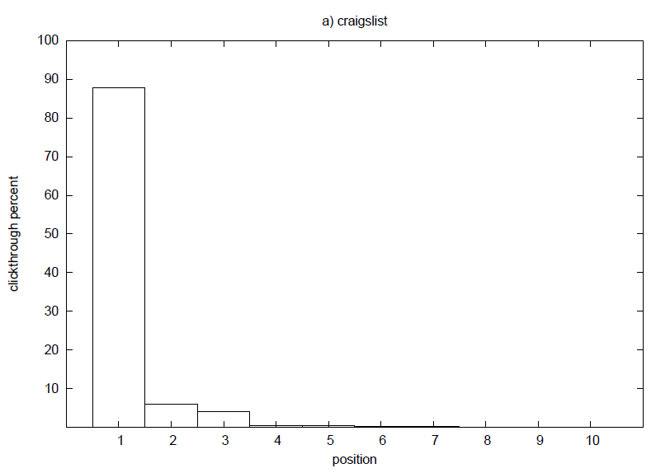
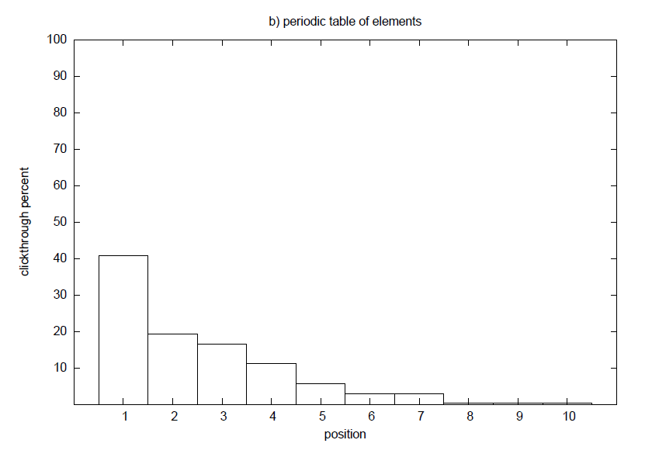
No Clickthrough Inversions
Figure 2: Clickthrough curves for queries: a) a stereotypical navigational query, b) a stereotypical informational query

Slide 8
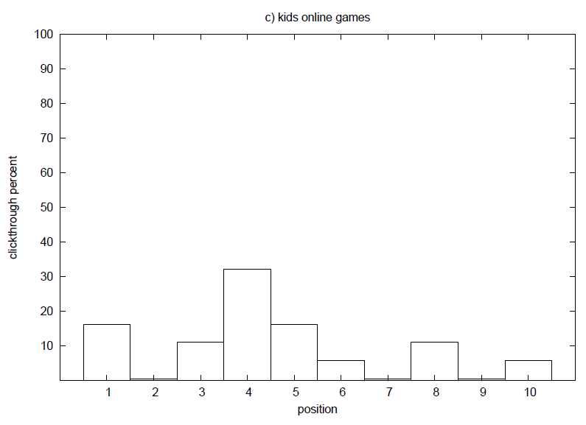
Observed Clickthrough Inversion
The search engine
May have failed in its primary goal, ranking more relevant results below less relevant results.
Or even when the relative ranking is appropriate, a caption may fail to reflect the content of the underlying page with respect to the query, leading the user to make an incorrect judgment.
Figure 2: Clickthrough curves for query c) a query exhibiting click-through inversions.

Slide 9
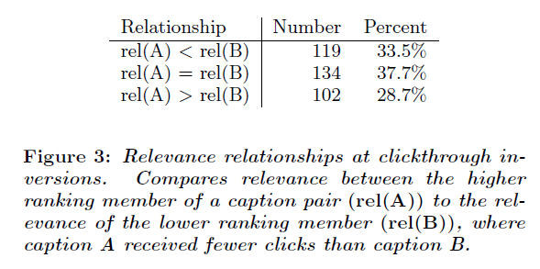
Clickthrough Inversion Relevance
The experiment
Used logs from 1,811 queries
Relevance determined by independent assessors viewing the pages
A was relevant only 28.7% which lead to the conclusion relevance alone is not enough.

Slide 10
Influence of Caption Features
.
As per the hypothesis,
the preference is due to
absence of snippet in A but
presence in B
However clickthrough inversions
may include this too
N (B)
N + 1 (A)
Notes:
About clickthrough

Slide 11
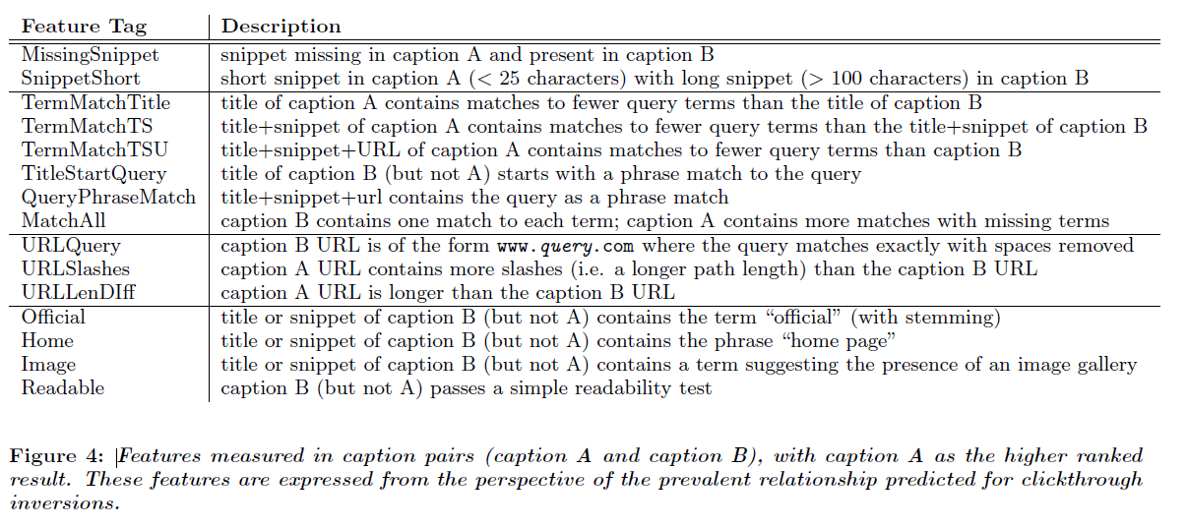
Caption Features

Slide 12
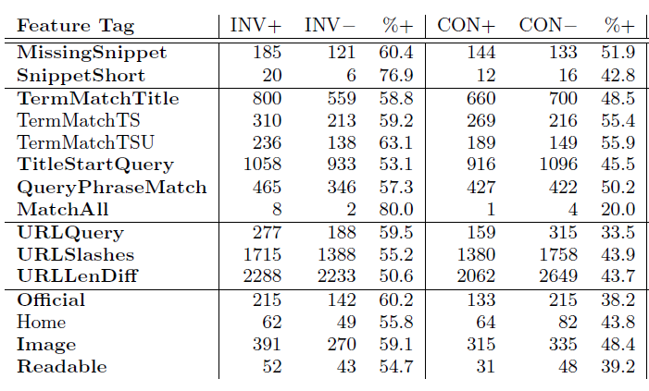
Results
caption A as the higher ranked
result
(+) favores B consistent with inversion
(-) favores A
Figure: 5 Page 7
Notes:
first set, containing
clickthrough inversions, as the INV set; we refer to the sec-
ond set, containing caption pairs for which the clickthroughs
are consistent with their rank order, as the CON set.

Slide 13
Conclusion
Missing snippets, short snippets and complex URLs affect clickthrough
Whenever possible all of the query terms should appear in the caption, reflecting their relationship to the associated page
When query terms are present in the title, they need not be repeated in the snippet URLs should be selected and displayed in a manner that emphasizes their relationship to the query

Slide 14
On Caption Bias in Interleaving Experiments

Slide 15
In This Paper
Training the following models on a sample of log data obtained
from a large commercial Web search engine
highlighting model
document-wise model
pairwise model
combined model
Two retrieval functions (also called rankers) are used for presenting users with a list of results that combines documents returned by the two rankers
The models were evaluated by comparing the results with human judgements

Slide 16
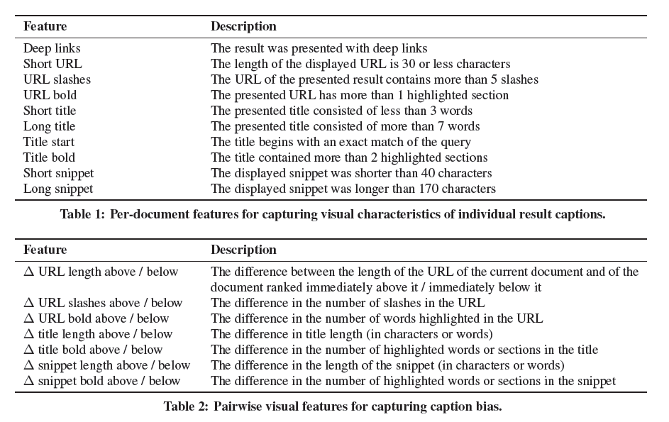
Caption Bias Features

Slide 17
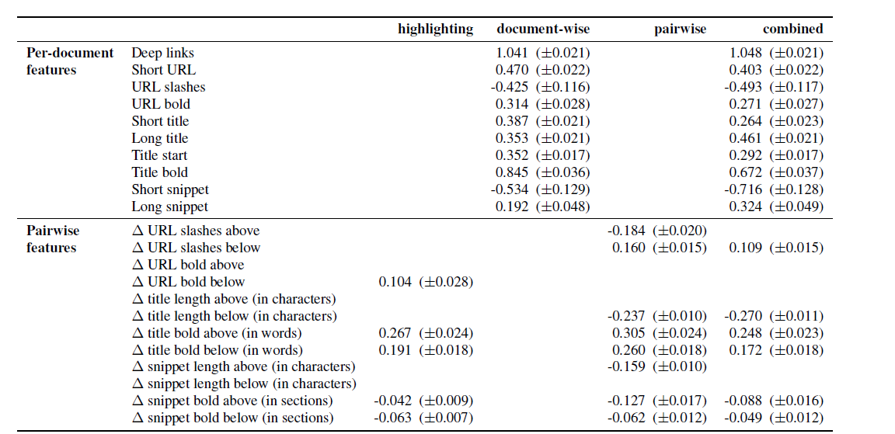
Evaluating Caption Bias Models
Table 3: Results (modeling caption bias): Visual features included in each trained model, with estimated regression weights and standard error of the weight estimates.
Notes:
by encoding all pairwise features as
ternary values (i.e., with possible values (􀀀1; 0; 1). Inorder to avoid individual features dominating the model.

Slide 18
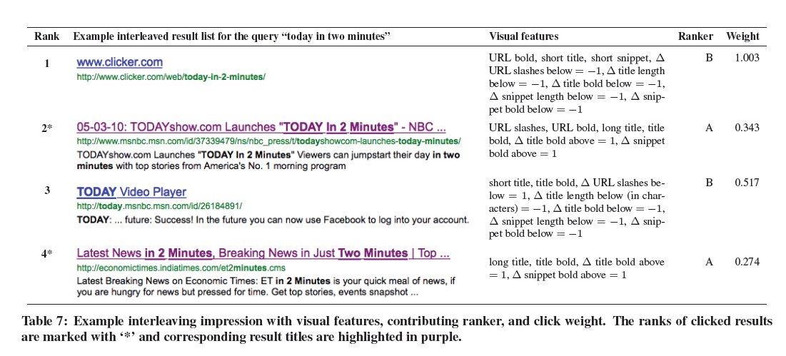
Result of Caption Features
In this result list, the two results with the lowest weights (i.e., the most attractive visually) were clicked by the user.
This suggests that click behavior may have been affected by caption features.

Slide 19
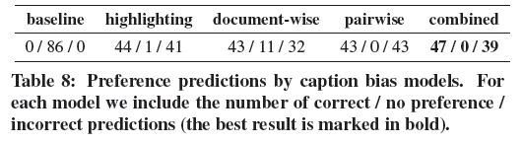
Predicting User Preferences
For the baseline model, no preferences can be inferred, as both URLs were clicked for the given query.
Prediction quality of the pairwise model is the same as a random model would achieve
Accuracy for the document-wise and highlighting models are slightly higher.
The best preference predictions are obtained by our combined model.
Notes:
baseline model, that does not take any visual features
into account (but is trained using relevance and position features,
and predicts click behavior using document position alone).

Slide 20
Why Does It Cite The First Paper?
They used the caption features that had longer snippets, shorter URLs, more query terms matching the caption, matches of the whole query as a phrase, if the caption was more readable
Also added new caption features that helped them to train the models and get precise click behavior of users

